Slide 1
Selenium L1

Slide 2
Contents

Slide 3
Contd..
5. JUnit Framework 6. Test Results
5.1 Testing Frameworks
5.2 JUnit Framework
5.3 JUnit Annotations
5.3.1 @Before
5.3.2 @Test
5.3.3 @After
5.3.4 @BeforeClass
5.3.5 @AfterClass
5.4 Reporting Results

Slide 4
1.What is Selenium
Notes:
Section breaker slide:
Used for a section heading. You may add a sub heading not exceeding one line also here
Section heading – Arial, bold, 34 font size, should not exceed beyond 1 line
Sub Head – Arial, normal, 20 font size, should not exceed beyond 1 line

Slide 5
1.1 Selenium Basics
Selenium automates browsers.
Selenium is one of the most well-known web testing automation tools.
Is a suite of tools to automate web browsers across many platforms including Microsoft Windows, Apple OS X, Linux.
Runs in many browsers including Firefox, Internet Explorer, Safari, Chrome, Opera
Can be controlled by many programming languages including Java, C#, Python, Ruby, PHP, Perl and JavaScript.
It is an open source project that allows testers and developers alike to develop functional tests to drive the browser.

Slide 6
1.2 Advantages of Selenium
Advantages of Selenium
Open Source license
Has a record and playback tool to create simple tests
Scripts can be executed on multiple browser – OS combinations with minimum changes
Can execute multiple tests at a time.
With multiple languages support for scripting, can be controlled using standard testing frameworks and be developed into robust automation suites

Slide 7
1.3 Disadvantages of Selenium
Disadvantages
Does not support automation of third party plugins like Flash, Flex within web pages
No Option to verify the images.
Detailed results are not available
Selenium IDE does not support conditional and looping statements and data driven testing

Slide 8
2.Selenium Components
Notes:
Section breaker slide:
Used for a section heading. You may add a sub heading not exceeding one line also here
Section heading – Arial, bold, 34 font size, should not exceed beyond 1 line
Sub Head – Arial, normal, 20 font size, should not exceed beyond 1 line

Slide 9
Selenium’s Components
Selenium is composed of multiple software tools(types). Each has a specific role. They are:
Selenium IDE
Firefox plugin that can be used to record and playback simple tests
Selenium 1 (aka. Selenium RC or Remote Control - Deprecated)
Is a client/server system that allows you to control web browsers locally or on other computers, using a programming language and testing framework
Selenium 2 (aka. Selenium Webdriver)
Can control a browser natively either locally or on other computers, using a programming language and testing framework
Selenium-Grid
Allows running tests on many computers at the same time, cutting down on time taken for cross OS-Browser testing, or simply break large test suites into multiple smaller suites and save time.
Notes:
Blank slide you may use this to insert or show screenshots etc
If content is added in this slide you will need to use bulleted text

Slide 10
Which part of Selenium is appropriate for you?
If you want to
create quick bug reproduction scripts
create scripts to aid in automation-aided exploratory testing
Then use Selenium IDE, a Firefox add-on that will do simple record-and-playback of interactions with the browser

Slide 11
Contd..
If you want to
create robust, browser-based regression automation
scale and distribute scripts across many environments
Then use Selenium WebDriver, a collection of language specific bindings to drive a browser -- the way it is meant to be driven.

Slide 12
3.Selenium IDE
Notes:
Section breaker slide:
Used for a section heading. You may add a sub heading not exceeding one line also here
Section heading – Arial, bold, 34 font size, should not exceed beyond 1 line
Sub Head – Arial, normal, 20 font size, should not exceed beyond 1 line

Slide 13
3.1 Selenium IDE Intro
The Selenium-IDE (Integrated Development Environment) is a prototyping tool for building test scripts.
It’s an easy-to-use Firefox plug-in and is generally the most quickest way to develop test cases.
This is not only a time-saver, but also an excellent way of learning Selenium script syntax.
Selenium IDE has a recording feature that allows testers and developers to record their actions as they follow the workflow that they need to test.
Recorded test can be played back only on Firefox browser
Recorded actions can be exported into scripts in multiple programming languages or HTML format for later use.
It has been developed using JavaScript so that it can interact with DOM (Document Object Model) using native JavaScript calls.
Notes:
Blank slide you may use this to insert or show screenshots etc
If content is added in this slide you will need to use bulleted text

Slide 14
3.2 Installing Selenium IDE
Go to http://seleniumhq.org/download/.
Click on the download link for Selenium IDE. You may get a message saying Firefox prevented this site (seleniumhq.org) from asking you to install software on your computer. If you do, click on the Allow button.
Notes:
Blank slide you may use this to insert or show screenshots etc
If content is added in this slide you will need to use bulleted text

Slide 15
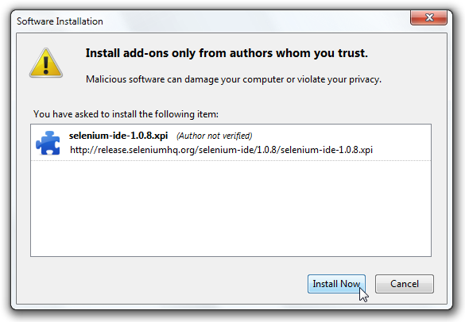
Contd..
When downloading from Firefox, you’ll be presented with the following window. Select Install Now.
Notes:
Horizontal Image slide – Horizontal image with bulleted text
Title – font size 20, Arial
Click on the icon to add image, the size of the image will be automatically determined once inserted, do not alter the size of the image
In the text box below the bulleted text should not be beyond one line
Font size should be 20, Arial normal and should not exceed beyond 4 bullet points

Slide 16
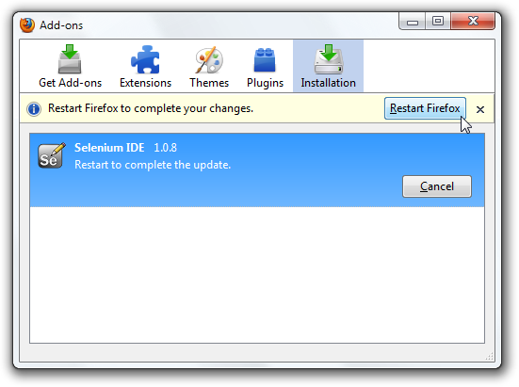
Contd..
.
The Firefox Add-ons window pops up, first showing a progress bar, and when the download is complete, displays the following. Restart Firefox.
Notes:
Horizontal Image slide – Horizontal image with bulleted text
Title – font size 20, Arial
Click on the icon to add image, the size of the image will be automatically determined once inserted, do not alter the size of the image
In the text box below the bulleted text should not be beyond one line
Font size should be 20, Arial normal and should not exceed beyond 4 bullet points

Slide 17
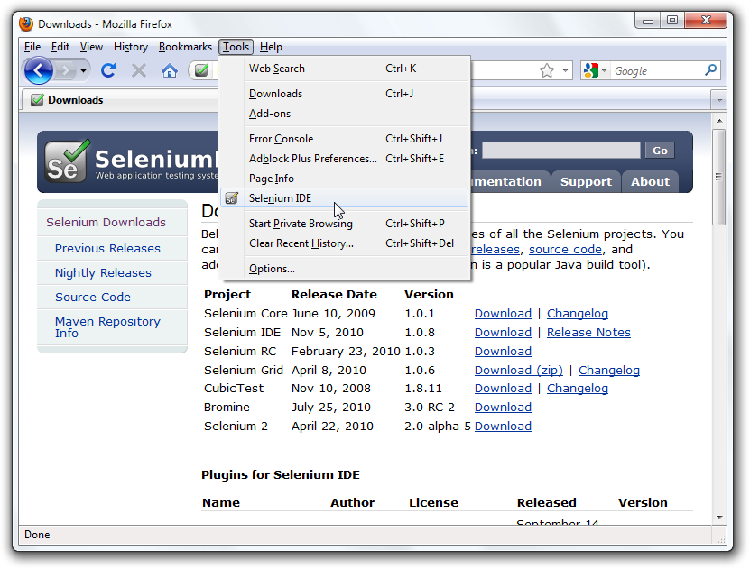
Contd..
After Firefox reboots you will find the Selenium-IDE listed under the Firefox Tools menu.
Notes:
Horizontal Image slide – Horizontal image with bulleted text
Title – font size 20, Arial
Click on the icon to add image, the size of the image will be automatically determined once inserted, do not alter the size of the image
In the text box below the bulleted text should not be beyond one line
Font size should be 20, Arial normal and should not exceed beyond 4 bullet points

Slide 18
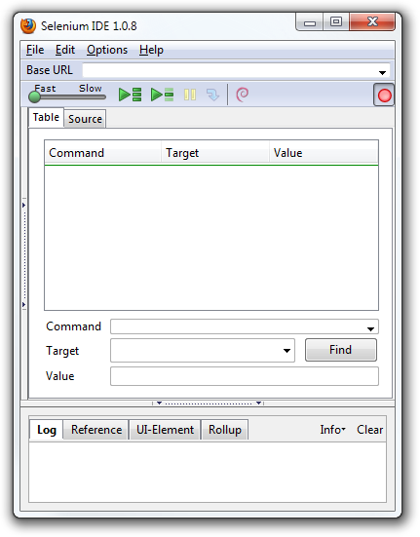
3.3 Opening the IDE
To run the Selenium-IDE, simply select it from the Firefox Tools menu. It opens as follows with an empty script-editing window and a menu for loading, or creating new test cases.
The three major components of Selenium IDE are Command, Target and Value.
Notes:
Horizontal Image slide – Horizontal image with bulleted text
Title – font size 20, Arial
Click on the icon to add image, the size of the image will be automatically determined once inserted, do not alter the size of the image
In the text box below the bulleted text should not be beyond one line
Font size should be 20, Arial normal and should not exceed beyond 4 bullet points

Slide 19
Selenium tool bar
The toolbar contains buttons for controlling the execution of your test cases, including a step feature for debugging your test cases. The right-most button, the one with the red-dot, is the record button.
Notes:
Horizontal Image slide – Horizontal image with bulleted text
Title – font size 20, Arial
Click on the icon to add image, the size of the image will be automatically determined once inserted, do not alter the size of the image
In the text box below the bulleted text should not be beyond one line
Font size should be 20, Arial normal and should not exceed beyond 4 bullet points

Slide 20
Selenium IDE icons
Base URL—This is the URL that the test will start. All open commands will be relative to the Base URL unless a full path is inserted in the open command.
Speed Slider—This is the slider under the Fast Slow labels on the screen.
Notes:
Horizontal Image slide – Horizontal image with bulleted text
Title – font size 20, Arial
Click on the icon to add image, the size of the image will be automatically determined once inserted, do not alter the size of the image
In the text box below the bulleted text should not be beyond one line
Font size should be 20, Arial normal and should not exceed beyond 4 bullet points

Slide 21
Contd..
Run all the tests in the IDE.
Run a single test in the IDE.
Pause a test that is currently running.
Step through the test once it has paused.
.
This is the record button. It will be engaged when the test is recording recording
Notes:
Horizontal Image slide – Horizontal image with bulleted text
Title – font size 20, Arial
Click on the icon to add image, the size of the image will be automatically determined once inserted, do not alter the size of the image
In the text box below the bulleted text should not be beyond one line
Font size should be 20, Arial normal and should not exceed beyond 4 bullet points

Slide 22
Selenium menu bar
The File menu has options for Test Case and Test Suite (suite of Test Cases).
Using these you can add a new Test Case, open a Test Case, save a Test Case, export Test Case in a language of your choice.
You can also open the recent Test Case. All these options are also available for Test Suite.
TO run the Selenium Test Suite in Selenium Ide we use Test Runner.
Notes:
Horizontal Image slide – Horizontal image with bulleted text
Title – font size 20, Arial
Click on the icon to add image, the size of the image will be automatically determined once inserted, do not alter the size of the image
In the text box below the bulleted text should not be beyond one line
Font size should be 20, Arial normal and should not exceed beyond 4 bullet points

Slide 23
Contd..
The Edit menu allows copy, paste, delete, undo, and select all operations for editing the commands in your test case.
The Options menu allows the changing of settings. You can set the timeout value for certain commands, add user-defined user extensions to the base set of Selenium commands, and specify the format (language) used when saving your test cases.
The Help menu is the standard Firefox Help menu; only one item on this menu–UI-Element Documentation–pertains to Selenium-IDE.
Notes:
Horizontal Image slide – Horizontal image with bulleted text
Title – font size 20, Arial
Click on the icon to add image, the size of the image will be automatically determined once inserted, do not alter the size of the image
In the text box below the bulleted text should not be beyond one line
Font size should be 20, Arial normal and should not exceed beyond 4 bullet points

Slide 24
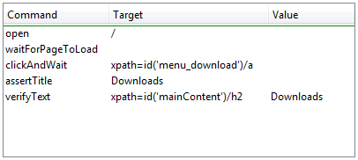
Test case pane in selenium IDE
Test script is displayed in the test case pane.
It has two tabs, one for displaying the command and their parameters in a readable “table” format.
Notes:
Horizontal Image slide – Horizontal image with bulleted text
Title – font size 20, Arial
Click on the icon to add image, the size of the image will be automatically determined once inserted, do not alter the size of the image
In the text box below the bulleted text should not be beyond one line
Font size should be 20, Arial normal and should not exceed beyond 4 bullet points

Slide 25
Contd..
The other tab - Source displays the test case in the native format in which the file will be stored.
By default, this is HTML although it can be changed to a programming language such as Java or C#, or a scripting language like Python.
The Source view also allows one to edit the test case in its raw form, including copy, cut and paste operations.
Notes:
Horizontal Image slide – Horizontal image with bulleted text
Title – font size 20, Arial
Click on the icon to add image, the size of the image will be automatically determined once inserted, do not alter the size of the image
In the text box below the bulleted text should not be beyond one line
Font size should be 20, Arial normal and should not exceed beyond 4 bullet points

Slide 26
Log/Reference/UI-Element/Rollup Pane
The bottom pane is used for four different functions–Log, Reference, UI-Element, and Rollup–depending on which tab is selected.
Log : When you run your test case, error messages and information messages showing the progress are displayed in this pane automatically.
Reference: The Reference tab is the default selection whenever you are entering or modifying Selenese commands and parameters in Table mode. In Table mode, the Reference pane will display documentation on the current command.
Notes:
Horizontal Image slide – Horizontal image with bulleted text
Title – font size 20, Arial
Click on the icon to add image, the size of the image will be automatically determined once inserted, do not alter the size of the image
In the text box below the bulleted text should not be beyond one line
Font size should be 20, Arial normal and should not exceed beyond 4 bullet points

Slide 27
Selenium Commands – “Selenese”
Selenium commands, often called Selenese, are the set of commands that run your tests. A sequence of these commands is a test script.
A command tells Selenium what to do. Selenium commands come in three “flavors”: Actions, Accessors, and Assertions.
Notes:
Horizontal Image slide – Horizontal image with bulleted text
Title – font size 20, Arial
Click on the icon to add image, the size of the image will be automatically determined once inserted, do not alter the size of the image
In the text box below the bulleted text should not be beyond one line
Font size should be 20, Arial normal and should not exceed beyond 4 bullet points

Slide 28
Actions, Accessors, and Assertions.
Actions are commands that generally manipulate the state of the application. They do things like “click this link” and “select that option”. If an Action fails, or has an error, the execution of the current test is stopped.
Accessors examine the state of the application and store the results in variables, e.g. “storeTitle”.
Assertions are like Accessors, but they verify that the state of the application conforms to what is expected.
Notes:
Horizontal Image slide – Horizontal image with bulleted text
Title – font size 20, Arial
Click on the icon to add image, the size of the image will be automatically determined once inserted, do not alter the size of the image
In the text box below the bulleted text should not be beyond one line
Font size should be 20, Arial normal and should not exceed beyond 4 bullet points

Slide 29
Script Syntax
Selenium commands are simple, they consist of the command and two parameters. For example:
The parameters are not always required; it depends on the command. In some cases both are required, in others one parameter is required, and in still others the command may take no parameters at all.
verifyText | //div//a[2] | Login
click | //div//a[2] | -
refresh | - | -
Notes:
Horizontal Image slide – Horizontal image with bulleted text
Title – font size 20, Arial
Click on the icon to add image, the size of the image will be automatically determined once inserted, do not alter the size of the image
In the text box below the bulleted text should not be beyond one line
Font size should be 20, Arial normal and should not exceed beyond 4 bullet points

Slide 30
Contd..
Parameters vary, however they are typically:
a locator for identifying a UI element within a page.
a text pattern for verifying or asserting expected page content
a text pattern or a selenium variable for entering text in an input field or for selecting an option from an option list.
Notes:
Horizontal Image slide – Horizontal image with bulleted text
Title – font size 20, Arial
Click on the icon to add image, the size of the image will be automatically determined once inserted, do not alter the size of the image
In the text box below the bulleted text should not be beyond one line
Font size should be 20, Arial normal and should not exceed beyond 4 bullet points

Slide 31
3.4 Commonly Used Selenium Commands
Open- opens a page using a URL.
click/ clickAndWait- performs a click operation, and optionally waits for a new page to load.
verifyTitle/ assertTitle- verifies an expected page title.
verifyTextPresent-verifies expected text is somewhere on the page.
verifyElementPresent- verifies an expected UI element, as defined by its HTML tag, is present on the page.
verifyText- verify expected text is present in given web element
verifyTable- verifies a table’s expected contents.
Notes:
Horizontal Image slide – Horizontal image with bulleted text
Title – font size 20, Arial
Click on the icon to add image, the size of the image will be automatically determined once inserted, do not alter the size of the image
In the text box below the bulleted text should not be beyond one line
Font size should be 20, Arial normal and should not exceed beyond 4 bullet points

Slide 32
Contd..
waitForPageToLoad- pauses execution until an expected new page loads. Called automatically when clickAndWait is used.
waitForElementPresent- pauses execution until an expected web element is present on the page.
Notes:
Horizontal Image slide – Horizontal image with bulleted text
Title – font size 20, Arial
Click on the icon to add image, the size of the image will be automatically determined once inserted, do not alter the size of the image
In the text box below the bulleted text should not be beyond one line
Font size should be 20, Arial normal and should not exceed beyond 4 bullet points

Slide 33
3.5 Difference between Assertion and Verification
Asset and Verify are used to validate the elements that are available on the webpage.
Verification checks many attributes of a page without aborting the test case on the first failure and will allow you to review all failures on the page and take the appropriate action.
Whereas Assertion will abort the test case on the first failure.
Effectively, an “assert” will fail the test and abort the current test case, whereas a “verify” will fail the test and continue to run the test case.
Notes:
Horizontal Image slide – Horizontal image with bulleted text
Title – font size 20, Arial
Click on the icon to add image, the size of the image will be automatically determined once inserted, do not alter the size of the image
In the text box below the bulleted text should not be beyond one line
Font size should be 20, Arial normal and should not exceed beyond 4 bullet points

Slide 34
3.6 Context Menu in Selenium
Selenium IDE contains a context menu that allows you to first select a UI element from the browser’s currently displayed page and then select from a list of Selenium commands with parameters pre-defined according to the context of the selected UI element.
This is not only a time-saver, but also an excellent way of learning Selenium script syntax.
Notes:
Horizontal Image slide – Horizontal image with bulleted text
Title – font size 20, Arial
Click on the icon to add image, the size of the image will be automatically determined once inserted, do not alter the size of the image
In the text box below the bulleted text should not be beyond one line
Font size should be 20, Arial normal and should not exceed beyond 4 bullet points

Slide 35
3.7 Echo- The Selenese Print Command
Selenese has a simple command that allows you to print text to your test’s output.
This is useful for providing informational progress notes in your test which display on the console as your test is running.
These notes also can be used to provide context within your test result reports, which can be useful for finding where a defect exists on a page in the event your test finds a problem. Finally, echo statements can be used to print the contents of Selenium variables.
Notes:
Horizontal Image slide – Horizontal image with bulleted text
Title – font size 20, Arial
Click on the icon to add image, the size of the image will be automatically determined once inserted, do not alter the size of the image
In the text box below the bulleted text should not be beyond one line
Font size should be 20, Arial normal and should not exceed beyond 4 bullet points

Slide 36
4.Locators
Notes:
Section breaker slide:
Used for a section heading. You may add a sub heading not exceeding one line also here
Section heading – Arial, bold, 34 font size, should not exceed beyond 1 line
Sub Head – Arial, normal, 20 font size, should not exceed beyond 1 line

Slide 37
4.1 Locating Elements
For many Selenium commands, a target is required.
This target identifies an element in the content of the web application, and consists of the location strategy followed by the location in the format locatorType=location.
The locator type can be omitted in many cases. The various locator types are:
Locating by Identifier
Locating by Id
Locating by name
Locating Hyperlinks by Link Text
Locating by XPath
Locating by CSS
Locating by DOM
Notes:
Horizontal Image slide – Horizontal image with bulleted text
Title – font size 20, Arial
Click on the icon to add image, the size of the image will be automatically determined once inserted, do not alter the size of the image
In the text box below the bulleted text should not be beyond one line
Font size should be 20, Arial normal and should not exceed beyond 4 bullet points

Slide 38
4.3 Locating by Identifier
Most common method of locating elements.
With this strategy, the first element with the id attribute value matching the location will be used. If no element has a matching id attribute, then the first element with a name attribute matching the location will be used.
Notes:
Horizontal Image slide – Horizontal image with bulleted text
Title – font size 20, Arial
Click on the icon to add image, the size of the image will be automatically determined once inserted, do not alter the size of the image
In the text box below the bulleted text should not be beyond one line
Font size should be 20, Arial normal and should not exceed beyond 4 bullet points

Slide 39
Contd..
For instance, your page source could have id and name attributes as follows:
<html>
<body>
<form id="loginForm">
<input name="username" type="text" />
<input name="password" type="password" />
<input name="continue" type="submit" value="Login" />
</form>
</body>
<html>
Notes:
Horizontal Image slide – Horizontal image with bulleted text
Title – font size 20, Arial
Click on the icon to add image, the size of the image will be automatically determined once inserted, do not alter the size of the image
In the text box below the bulleted text should not be beyond one line
Font size should be 20, Arial normal and should not exceed beyond 4 bullet points

Slide 40
Contd..
The following locator strategies would return the elements from the HTML snippet
identifier=loginForm
identifier=password
identifier=continue
Continue
Since the identifier type of locator is the default, the identifier= in the first three examples above is not necessary.
Notes:
Horizontal Image slide – Horizontal image with bulleted text
Title – font size 20, Arial
Click on the icon to add image, the size of the image will be automatically determined once inserted, do not alter the size of the image
In the text box below the bulleted text should not be beyond one line
Font size should be 20, Arial normal and should not exceed beyond 4 bullet points

Slide 41
4.2 Locating by Id and Name
ID locator is used when you know an element’s “id” attribute.
Example( for below html snippet): id=loginForm
The name locator type will locate the first element with a matching name attribute.
Example: name=username
For instance, your page source could have id and name attributes as follows:
<html>
<body>
<form id="loginForm">
<input name="username" type="text" />
<input name="password" type="password" />
<input name="continue" type="submit" value="Login" />
</form>
</body>
<html>
Notes:
Horizontal Image slide – Horizontal image with bulleted text
Title – font size 20, Arial
Click on the icon to add image, the size of the image will be automatically determined once inserted, do not alter the size of the image
In the text box below the bulleted text should not be beyond one line
Font size should be 20, Arial normal and should not exceed beyond 4 bullet points

Slide 42
Contd..
These three types of locators allow Selenium to test a UI element independent of its location on the page.
They are also the fastest in terms of performance
Well named “id” and “name” make the code more readable too
Notes:
Horizontal Image slide – Horizontal image with bulleted text
Title – font size 20, Arial
Click on the icon to add image, the size of the image will be automatically determined once inserted, do not alter the size of the image
In the text box below the bulleted text should not be beyond one line
Font size should be 20, Arial normal and should not exceed beyond 4 bullet points

Slide 43
4.3 Locating by Link Text
This is a simple method of locating a hyperlink in your web page by using the text of the link. If two links with the same text are present, then the first match will be used.
<html>
<body>
<p>Are you sure you want to do this?</p>
<a href="continue.html">Continue</a>
<a href="cancel.html">Cancel</a>
</body>
<html>
link=Continue
link-Cancel
Notes:
Horizontal Image slide – Horizontal image with bulleted text
Title – font size 20, Arial
Click on the icon to add image, the size of the image will be automatically determined once inserted, do not alter the size of the image
In the text box below the bulleted text should not be beyond one line
Font size should be 20, Arial normal and should not exceed beyond 4 bullet points

Slide 44
4.4 Locating by XPath
XPath is the language used for locating nodes in an XML document using path expressions. It can also be written for HTML as HTML is also one form of XML.
XPath can be used to either locate the element in absolute terms (not advised), or relative to an element that does have an id or name attribute.
Absolute XPaths contain the location of all elements from the root (html) and as a result are likely to fail with only the slightest adjustment to the application.
Example - /html/body/form/input[@type=‘submit’]
‘/’ selects root node i.e. html
For instance, your page source could have structure as follows:
<html>
<body>
<form id="loginForm">
<input type="text" />
<input type="password" />
<input type="submit" value="Login" />
</form>
</body>
<html>
Notes:
Horizontal Image slide – Horizontal image with bulleted text
Title – font size 20, Arial
Click on the icon to add image, the size of the image will be automatically determined once inserted, do not alter the size of the image
In the text box below the bulleted text should not be beyond one line
Font size should be 20, Arial normal and should not exceed beyond 4 bullet points

Slide 45
Contd..
By finding a nearby element with an id or name attribute , you can locate your target element based on the relationship. This is much less likely to change and can make your tests more robust
Example - //form[@id=‘loginForm’]/input[@type=‘submit’]
‘//’ – selects any matching node, in this case a ‘form’
This is less likely to break in comparison with the absolute XPath
* wildcard refers to any node. For example, //*[@id=‘loginForm’]
@ refers to attribute name
Nodes can be referred by index. For example, //form[@id=‘loginForm’]/input[3] refers to third input element in the tree structure
Operators are supported. For example, //form[@id=‘loginForm’]/input[@type=‘submit’ and @value=‘Login’]
There are useful string functions like contains, starts-with. For example, //a[contains(text(), ‘account’)] matches <a>John’s account </a>
Notes:
Horizontal Image slide – Horizontal image with bulleted text
Title – font size 20, Arial
Click on the icon to add image, the size of the image will be automatically determined once inserted, do not alter the size of the image
In the text box below the bulleted text should not be beyond one line
Font size should be 20, Arial normal and should not exceed beyond 4 bullet points

Slide 46
Contd..
<html>
<body>
<form id="loginForm">
<input name="username" type="text" />
<input name="password" type="password" />
<input name="continue" type="submit" value="Login" />
<input name="continue" type="button" value="Clear" />
</form>
</body>
<html>
xpath=/html/body/form[1] - Absolute path (would break if the HTML was changed only slightly)
//form[1] - First form element in the HTML
xpath=//form[@id='loginForm'] - The form element with attribute named ‘id’ and the value ‘loginForm
Notes:
Horizontal Image slide – Horizontal image with bulleted text
Title – font size 20, Arial
Click on the icon to add image, the size of the image will be automatically determined once inserted, do not alter the size of the image
In the text box below the bulleted text should not be beyond one line
Font size should be 20, Arial normal and should not exceed beyond 4 bullet points

Slide 47
4.5 Locating by CSS
CSS (Cascading Style Sheets) is a language for describing the rendering of HTML and XML documents.
CSS uses Selectors for binding style properties to elements in the document.
These Selectors can be used by Selenium as another locating strategy.
“>” refers to child element. Example – “div > a” refers to “a” tag which is child of “div” tag
Whitespace refers to an element which is inside or one of it’s children of reference element. Example – “div a” refers to “a” tag which is inside of “div” tag
Id attribute is referred to with #. Example - <div id=‘example’> is referred as “div#example”
Class attribute is referred to with dot. Example - <div class=‘example’> is referred as “div.example”
Notes:
Horizontal Image slide – Horizontal image with bulleted text
Title – font size 20, Arial
Click on the icon to add image, the size of the image will be automatically determined once inserted, do not alter the size of the image
In the text box below the bulleted text should not be beyond one line
Font size should be 20, Arial normal and should not exceed beyond 4 bullet points

Slide 48
4.6 Locating by DOM
The Document Object Model represents an HTML document and can be accessed using JavaScript. This location strategy takes JavaScript that evaluates to an element on the page, which can be simply the element’s location using the hierarchical dotted notation.
Since only dom locators start with “document”, it is not necessary to include the dom= label when specifying a DOM locator.
Notes:
Horizontal Image slide – Horizontal image with bulleted text
Title – font size 20, Arial
Click on the icon to add image, the size of the image will be automatically determined once inserted, do not alter the size of the image
In the text box below the bulleted text should not be beyond one line
Font size should be 20, Arial normal and should not exceed beyond 4 bullet points

Slide 49
Contd..
<html>
<body>
<form id="loginForm">
<input name="username" type="text" />
<input name="password" type="password" />
<input name="continue" type="submit" value="Login" />
<input name="continue" type="button" value="Clear" />
</form>
</body>
<html>
dom =document.getElementById('loginForm')
dom=document.forms ['loginForm']
dom=document.forms [0]
Notes:
Horizontal Image slide – Horizontal image with bulleted text
Title – font size 20, Arial
Click on the icon to add image, the size of the image will be automatically determined once inserted, do not alter the size of the image
In the text box below the bulleted text should not be beyond one line
Font size should be 20, Arial normal and should not exceed beyond 4 bullet points

Slide 50
4.7 Matching Text Patterns
Like locators, patterns are a type of parameter frequently required by Selenese commands.
There are three types of patterns: globbing, regular expressions, and exact
To specify a globbing pattern parameter for a Selenese command, you can prefix the pattern with a glob: label.
Regular expression patterns in Selenese need to be prefixed with either regexp: or regexpi:. The former is case-sensitive; the latter is case-insensitive.
Notes:
Horizontal Image slide – Horizontal image with bulleted text
Title – font size 20, Arial
Click on the icon to add image, the size of the image will be automatically determined once inserted, do not alter the size of the image
In the text box below the bulleted text should not be beyond one line
Font size should be 20, Arial normal and should not exceed beyond 4 bullet points

Slide 51
4.8 Firebug
It integrates with firefox to edit, debug, and monitor CSS, HTML, and JavaScript live in any web page.
CSS and XPath of an web element can be found using firebug.
Once firebug is installed, firebug can be opened using F12 after opening the browser.
Using inspect button, the CSS and XPath can be found of any web element.

Slide 52
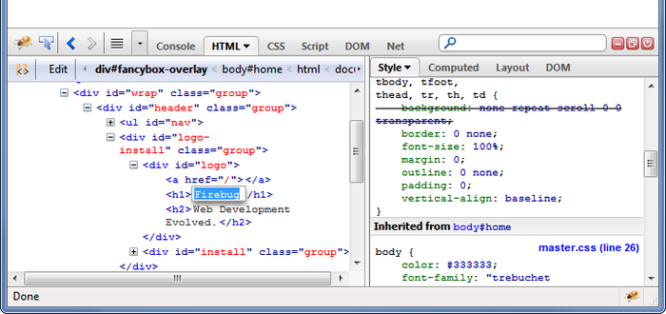
Contd..

Slide 53
5.Selenium Webdriver
Notes:
Section breaker slide:
Used for a section heading. You may add a sub heading not exceeding one line also here
Section heading – Arial, bold, 34 font size, should not exceed beyond 1 line
Sub Head – Arial, normal, 20 font size, should not exceed beyond 1 line

Slide 54
5.1 Selenium Web-Driver
It is designed to providing an simpler, more concise programming interface.
It addresses some limitations in the Selenium-RC API.
It was developed to better support dynamic web pages where elements of a page may change without the page itself being reloaded.
It’s goal is to supply a well-designed object-oriented API that provides improved support for modern advanced web-app testing problems
Selenium-Web Driver makes direct calls to the browser using each browser’s native support for automation.

Slide 55
5.2 Selenium Server
Selenium Server replaces Selenium Remote Control. It can be used when tests and browser run on different machines. For example, you need to execute tests on a different version of browser installed on another machine.
It is also used to driver HtmlUnitDriver, when not using Java bindings
Can be configured as grid

Slide 56
5.3 Advantages of Webdriver over Selenium RC
Webdriver APIs are object oriented and offer better usage
Webdriver controls browsers natively from browser level
Unlike RC you don't have to start a server in webdriver.
Executions are faster in Webdriver
Interactions with web elements are more realistic. For example, Webdriver does not allow editing text in a disabled text field
You can find coordinates of any object using Webdriver

Slide 57
Contd…
Keyword driven framework is very easy to build in webdriver.
Smaller, compact API. Web Driver's API is more Object Oriented than the original Selenium RC API. This can make it easier to work with.
Support by browser vendors, like Opera, Mozilla and Chrome for the development of WD.

Slide 58
5.4 Webdriver API
Webdriver is a platform and language neutral interface and associated wire protocol that allows programs or scripts to introspect into, and control the behavior of, a web browser
The API is defined by a wire protocol and a set of interfaces to discover and manipulate DOM elements on a web page, and to control the behavior of the containing browser
This specification also includes a normative reference serialization (to JSON over HTTP) of the interface's invocations and responses that are to be used by browser vendors to ensure interoperability
Selenium Webdriver merges the open source projects Selenium and Webdriver and is named as Selenium 2
Selenium Webdriver client libraries are available in various languages like Java, C#, Ruby, Python, JavaScript etc.
The drivers implementing Webdriver API are available for all major browsers like Internet Explorer, Firefox, Safari, Chrome, Opera and mobile platforms like Android, iOS, Windows Phone, Blackberry etc

Slide 59
5.4 Webdriver Interface
The main interface to use for testing, which represents an idealized web browser. The methods in this interface fall into three categories:-
Control of the browser itself – get(), navigate(), manage(), close(), quit(), switchTo()
Selection of web elements – findElement(), findElements()
Debugging aids – getCurrentUrl(), getPageSource(), getTitle(), getWindowHandle(), getWindowHandles()
Important methods
Reference - http://selenium.googlecode.com/git/docs/api/java/org/openqa/selenium/WebDriver.html
Method | Description
get() | Loads a new web page in the current browser window
findElement() | Find the first web element using a locator strategy like id, name, xpath
switchTo() | Sends future commands to a different frame or window
quit() | Quits driver, closing every associated window

Slide 60
5.4 WebElement Interface
Represents a HTML element. All interactions with a web page will be performed through this interface. The methods in this interface fall into three categories:-
Interaction with the web element – sendKeys(), click(), clear(), submit()
Getting information on the web element – getText(), getAttribute(), getCssValue(), getLocation(), getSize(), getTagName(), isDisplayed(), isEnabled, isSelected()
Finding child elements within the current context – findElement(), findElements()
Important methods
Reference - http://selenium.googlecode.com/git/docs/api/java/org/openqa/selenium/WebElement.html
Method | Description
click() | Click on the web element
sendKeys() | Simulate typing into an element
getText() | Get the visible inner text of the element
isDisplayed() | Checks if the element is displayed

Slide 61
5.5 Selenium-Web Driver's Drivers
Web Driver is the name of the key interface against which tests should be written, but there are several implementations. These include:
1) HtmlUnit Driver:
This is currently the fastest and most lightweight implementation of Web Driver. As the name suggests, this is based on HtmlUnit. HtmlUnit is a java based implementation of a Web Browser without a GUI. For any language binding (other than java) the Selenium Server is required to use this driver.

Slide 62
Contd…
2) Firefox Driver:
Controls the Firefox browser using a Firefox plug-in. The Firefox Profile that is used is stripped down from what is installed on the machine to only include the Selenium WebDriver.xpi (plug-in). Firefox Driver is capable of being run and is tested on Windows, Mac, Linux.
Runs in a real browser and supports JavaScript
Faster than the Internet Explorer Driver
Reference - https://github.com/SeleniumHQ/selenium/wiki/FirefoxDriver

Slide 63
Contd…
3) Internet Explorer Driver:
* This driver is controlled by a .dll and is thus only available on Windows OS. Each Selenium release has it’s core functionality tested against versions 6, 7 and 8 on XP, and 9 on Windows7.
Runs in a real browser and supports JavaScript with all the quirks your end users see.
Comparatively slow
Requires IEDriverServer.exe component and the path should be set in webdriver.ie.driver system variable
XPath is not natively supported in most versions. CSS is not natively supported in versions 6 and 7.
Reference - https://github.com/SeleniumHQ/selenium/wiki/InternetExplorerDriver

Slide 64
Contd…
4) Chrome Driver:
Chrome Driver is maintained / supported by the Chromium project itself. WebDriver works with Chrome through the chromedriver binary (found on the chromium project’s download page). You need to have both chromedriver and a version of chrome browser installed. chromedriver needs to be placed somewhere on your system’s path in order for WebDriver to automatically discover it.
Runs in a real browser and supports JavaScript
Slower than the HtmlUnit Driver
Requires a server component to be started. Path to the Chromedriver executable should be set in webdriver.chrome.driver variable.
Reference - https://github.com/SeleniumHQ/selenium/wiki/ChromeDriver

Slide 65
Contd…
4) Safari Driver:
Safari Driver is implemented as a Safari browser extension. The driver inverts the traditional client/server relationship and communicates with the Webdriver client using Websockets
Runs in a real browser and supports JavaScript
Slower than the HtmlUnit Driver
File upload is NOT supported

Slide 66
6. JUnit framework
Notes:
Section breaker slide:
Used for a section heading. You may add a sub heading not exceeding one line also here
Section heading – Arial, bold, 34 font size, should not exceed beyond 1 line
Sub Head – Arial, normal, 20 font size, should not exceed beyond 1 line

Slide 67
6.1 Testing frameworks
A software framework is a universal, reusable software platform used to develop applications, products and solutions.
Software frameworks include support programs, compilers, code libraries, an application programming interface (API) and tool sets that bring together all the different components to enable development of a project or solution.
Notes:
Horizontal Image slide – Horizontal image with bulleted text
Title – font size 20, Arial
Click on the icon to add image, the size of the image will be automatically determined once inserted, do not alter the size of the image
In the text box below the bulleted text should not be beyond one line
Font size should be 20, Arial normal and should not exceed beyond 4 bullet points

Slide 68
Contd..
The Testing framework is responsible for:
defining the format in which to express expectations
creating a mechanism to hook into or drive the application under test
executing the tests
reporting results
There are two widely used testing frameworks in Java:
JUnit
TestNG
Notes:
Horizontal Image slide – Horizontal image with bulleted text
Title – font size 20, Arial
Click on the icon to add image, the size of the image will be automatically determined once inserted, do not alter the size of the image
In the text box below the bulleted text should not be beyond one line
Font size should be 20, Arial normal and should not exceed beyond 4 bullet points

Slide 69
6.2 JUnit framework
JUnit in version 4.x is a test framework which uses annotations to identify methods that are test methods.
Typically these test methods are contained in a class which is only used for testing.
To write a test with JUnit you annotate a method with the @org.junit.Test annotation and use a method provided by JUnit to check the expected result of the code execution versus the actual result.
Eclipse IDE user interface or the org.junit.runner.JUnitCore class is used to run the test.
Notes:
Horizontal Image slide – Horizontal image with bulleted text
Title – font size 20, Arial
Click on the icon to add image, the size of the image will be automatically determined once inserted, do not alter the size of the image
In the text box below the bulleted text should not be beyond one line
Font size should be 20, Arial normal and should not exceed beyond 4 bullet points

Slide 70
6.3 JUnit annotations
@Test public void method() | The annotation @Test identifies that a method is a test method. Declare as public to allow JUnit core class to have visibility to test method
@Before public void method() | Executes the method before each test. This method can prepare the test environment (e.g. read input data, initialize the class).
@After public void method() | Executes the method after each test. This method can cleanup the test environment (e.g. delete temporary data, restore defaults).
Notes:
Horizontal Image slide – Horizontal image with bulleted text
Title – font size 20, Arial
Click on the icon to add image, the size of the image will be automatically determined once inserted, do not alter the size of the image
In the text box below the bulleted text should not be beyond one line
Font size should be 20, Arial normal and should not exceed beyond 4 bullet points

Slide 71
Contd..
@BeforeClass public static void method() | Executes the method once, before the start of all tests. This can be used to perform time intensive activities, for example to connect to a database. Methods annotated with this annotation need a static modifier to work with JUnit.
@AfterClass public static void method() | Executes the method once, after all tests have been finished. This can be used to perform clean-up activities, for example to disconnect from a database. Methods annotated with @AfterClass need a static modifier to work with JUnit.
@Ignore | Ignores the test method. This is useful when the underlying code has been changed and the test case has not yet been adapted. Or if the execution time of this test is too long to be included.
Notes:
Horizontal Image slide – Horizontal image with bulleted text
Title – font size 20, Arial
Click on the icon to add image, the size of the image will be automatically determined once inserted, do not alter the size of the image
In the text box below the bulleted text should not be beyond one line
Font size should be 20, Arial normal and should not exceed beyond 4 bullet points

Slide 72
Contd..
@Test (expected = Exception.class) | Fails, if the method does not throw the named exception.
@Test(timeout=100) | Fails, if the method takes longer than 100 milliseconds.
Notes:
Horizontal Image slide – Horizontal image with bulleted text
Title – font size 20, Arial
Click on the icon to add image, the size of the image will be automatically determined once inserted, do not alter the size of the image
In the text box below the bulleted text should not be beyond one line
Font size should be 20, Arial normal and should not exceed beyond 4 bullet points

Slide 73
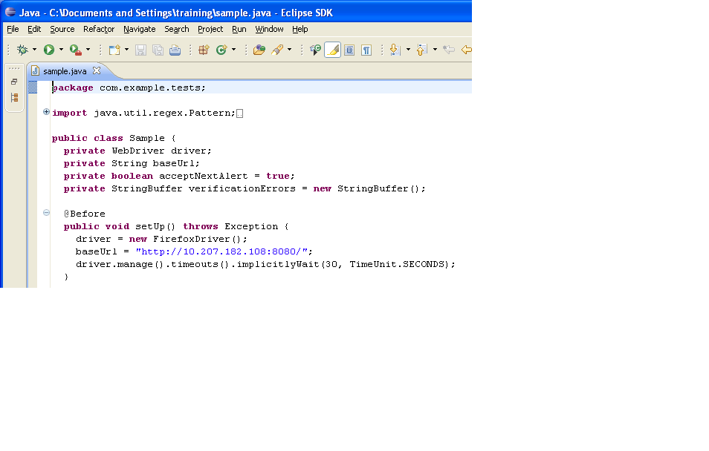
6.3.1 @Before

Slide 74
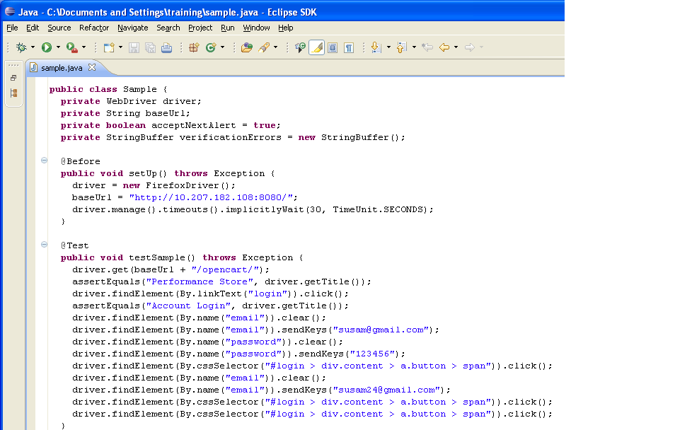
6.3.2 @Test

Slide 75
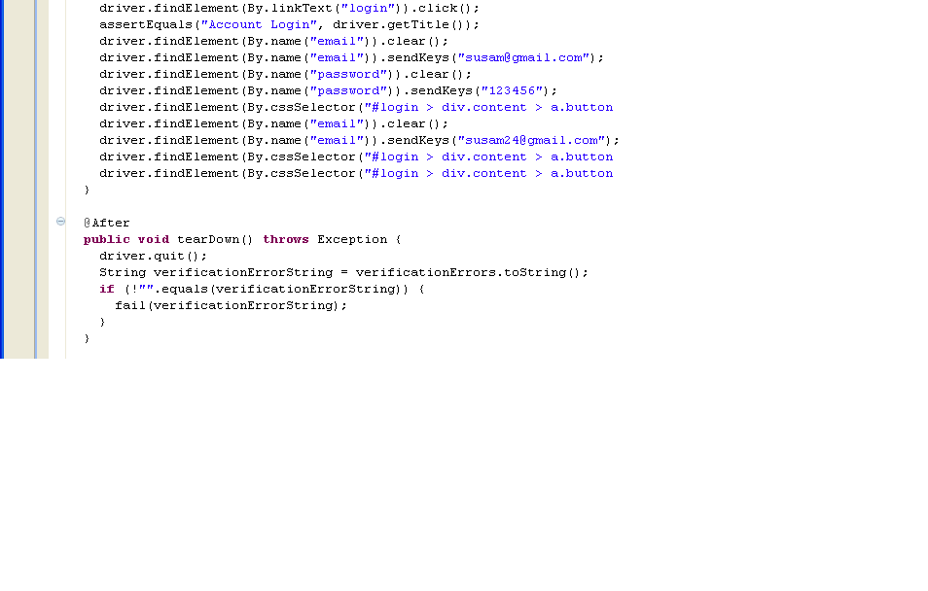
6.3.3 @After

Slide 76
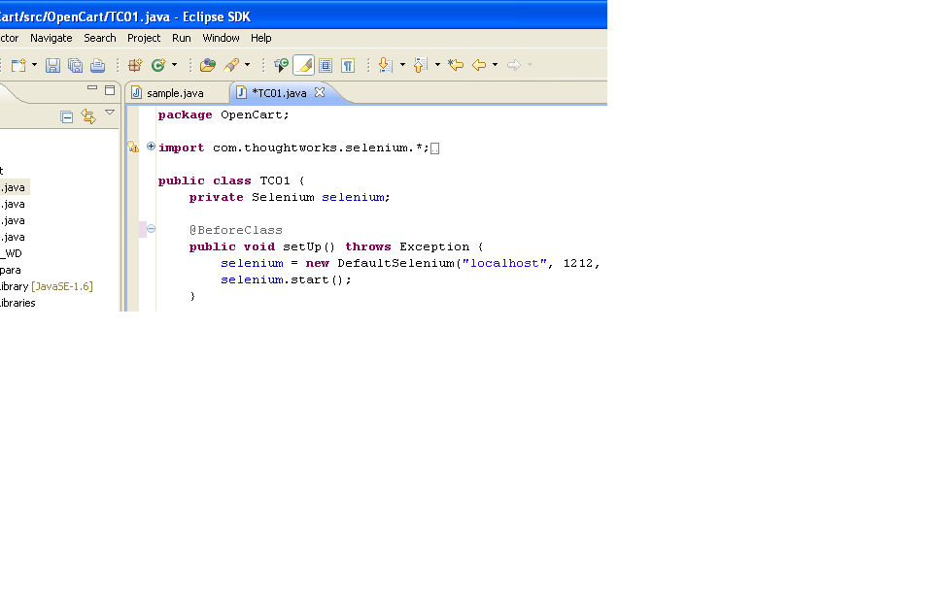
6.3.4 @BeforeClass

Slide 77
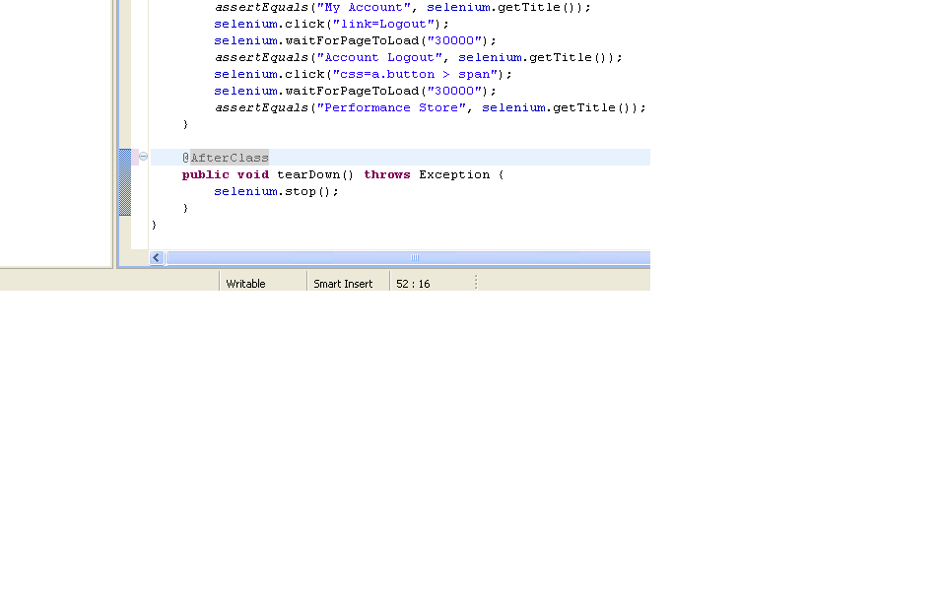
6.3.5 @AfterClass

Slide 78
Reference
Relevant topics in http://www.seleniumhq.org/docs/
HTML Tutorial at http://www.w3schools.com/html/default.asp
JavaScript Tutorial at http://www.w3schools.com/js/default.asp
CSS Tutorial at http://www.w3schools.com/css/default.asp
XPath Tutorial at http://www.w3schools.com/xpath/default.asp
CSS Selectors at https://saucelabs.com/resources/selenium/css-selectors
Relevant topics in https://github.com/junit-team/junit/wiki
Videos in CoE Repository
RealSteel Project Executions in the CoE
WebDriver W3C http://www.w3.org/TR/webdriver/#navigation
Simon Stewart on Selenium http://www.aosabook.org/en/selenium.html
Webdriver Javadoc http://selenium.googlecode.com/git/docs/api/java/allclasses-noframe.html
(these must be referred mandatorily before appearing UCF)

Slide 79
Thank You
Notes:
Thank you slide:
Thankyou– font size 30, Arial Bold
Name & Designation – font size 18, Arial normal
Your/contact email id – font size 18, Arial normal

